Slide 1

AI Driven Sign Language Interpreter Using Deep Learning and Real-time Hand Gesture Recognition
MLA0408 - Deep Learning
GUIDED BY
Dr. D Sudhagar
PRESENTED BY
Arya. B. Nair ( 192424133 )

Slide 2


ABSTRACT
Communication between hearing-impaired individuals and people who do not understand sign language remains a significant challenge in everyday life. Existing communication methods often require human interpreters or specialized devices, limiting accessibility and convenience.
The proposed AI Sign Language Translator utilizes deep learning and computer vision to recognize hand gestures captured through a standard webcam and translate them into readable text and optional speech output in real time.
By combining real-time hand detection, gesture recognition, and intelligent translation, the system provides an accessible, non-intrusive, and user-friendly solution that enables smoother communication between sign language users and the general public without requiring expensive hardware or wearable devices.

Slide 3
INTRODUCTION
Sign language is one of the primary means of communication for individuals with hearing or speech impairments. However, many people are unable to understand sign language, creating communication barriers in educational institutions, workplaces, hospitals, and public services.
The AI Sign Language Translator leverages deep learning and computer vision to recognize hand gestures through a standard webcam and instantly convert them into readable text and optional speech output.
Importances:
This system:
Enables real-time communication between sign language users and non-signers.
Eliminates the need for a human interpreter in many day-to-day situations.
Utilizes deep learning models for accurate gesture recognition.
Provides an affordable, contactless, and user-friendly communication solution.

Slide 4
PROBLEM STATEMENTS & OBJECTIVES
PROBLEM STATEMENT
Communication between hearing-impaired individuals and people who do not understand sign language remains a major challenge in daily life. Existing solutions often depend on human interpreters, specialized hardware, or limited mobile applications, which may not always be accessible or available.
There is a need for an affordable, accurate, and real-time system that can recognize sign language gestures and translate them into text and speech, enabling seamless communication in various real-world environments.
OBJECTIVES
To capture sign language gestures in real time using computer vision.
To recognize hand gestures accurately using a deep learning model.
To translate recognized signs into readable text and optional speech output.
To provide an accessible and user-friendly communication system without requiring specialized equipment.

Slide 5
LITERATURE SURVEY
S. No | Research Paper | Author & Year | Advantages | Disadvantages | Technologies Used
1 | Real-Time Sign Language Recognition Using Deep Learning | Shukla & Sharma (2025) | High recognition accuracy with real-time performance | Requires a large and diverse training dataset | CNN, TensorFlow, OpenCV
2 | Hand Gesture Recognition Using MediaPipe and LSTM Networks | Kumar & Singh (2024) | Effectively recognizes dynamic hand gestures | Performance depends on lighting and camera quality | MediaPipe Hands, LSTM, Python
3 | Deep Learning-Based Sign Language Recognition for Human–Computer Interaction | Lee et al. (2024) | Supports natural and contactless interaction | Computationally intensive for real-time deployment | CNN, ResNet, Computer Vision
4 | Vision-Based Sign Language Translation Using Transformer Networks | Ahmed et al. (2023) | Better understanding of sequential gestures and sentences | Requires high computational resources and large datasets | Vision Transformer, Attention Mechanism, PyTorch
5 | Real-Time Hand Gesture Recognition Using Deep Learning and Computer Vision | Patel & Verma (2023) | Low-cost solution using standard webcams | Accuracy decreases with occluded or overlapping hands | OpenCV, CNN, TensorFlow

Slide 6
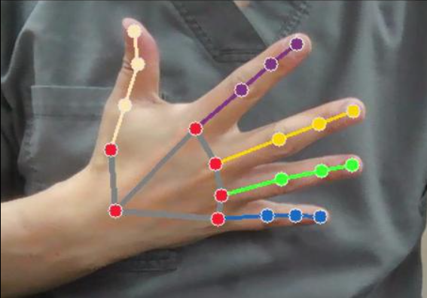
MODULE 1: LIVE SIGN CAPTURE MODULE
WHAT IS DOES?
This module captures live video through a webcam and detects the user's hands using MediaPipe Hands. It continuously tracks the position of the hands and extracts important landmarks required for sign language recognition.
KEY FUNCTIONS:
Captures real-time video input from the webcam.
Detects one or both hands in each frame.
Continuously tracks hand movements for gesture recognition.

Slide 7
MODULE 2: INTELLIGENT SIGN RECOGNITION MODULE
WHAT IS DOES?
This module processes the detected hand landmarks and analyzes them using a trained deep learning model. It recognizes the performed sign and classifies it as a letter, word, or phrase, enabling accurate interpretation of sign language gestures.
KEY FUNCTIONS:
Processes hand landmark coordinates extracted from MediaPipe.
Uses a trained deep learning model (CNN/LSTM) for gesture recognition.
Classifies signs into letters, words, or predefined phrases.

Slide 8
MODULE 3: TRANSATION AND COMMUNICATION INTERFACE
WHAT IS DOES?
This module converts the recognized sign language gestures into readable text and optional speech output. It provides users with an intuitive interface that displays the live camera feed, recognized gestures, translated text, and speech output, enabling effective communication in real time.
KEY FUNCTIONS:
Converts recognized signs into readable text.
Displays live video, detected sign, and translated output on the interface.
Provides real-time communication between sign language users and non-signers.

Slide 9
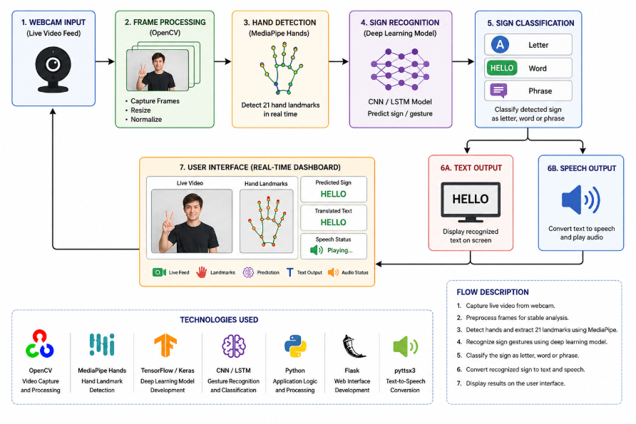
SYSTEM ARCHITECTURE

Slide 10
RESULTS
The AI Sign Language Translator was successfully developed and tested using a standard webcam for real-time gesture recognition.
The system accurately detected hand landmarks and recognized sign language gestures using a deep learning model.
Real-time translation of recognized signs into readable text was successfully achieved.
Optional text-to-speech functionality converted translated text into natural voice output for improved accessibility.
The system provided smooth and responsive communication through continuous live gesture recognition.
The proposed solution demonstrated an affordable, contactless, and user-friendly approach to improving communication between sign language users and non-signers.
The AI Sign Language Translator was successfully implemented and evaluated under different hand gestures, lighting conditions, and user interactions.

Slide 11
FUTURE ENHANCEMENTS
Support recognition of continuous sign language sentences instead of individual letters or words using Transformer-based sequence models.
Develop a mobile application for Android and iOS to enable sign language translation anywhere using a smartphone camera.
Integrate multilingual translation, allowing recognized signs to be converted into multiple spoken and written languages.
Expand the gesture database to include regional and international sign languages, improving the system's versatility and accessibility.
Enhance the deep learning model with advanced architectures and larger datasets to improve recognition accuracy under varying lighting conditions, backgrounds, and hand orientations.

Slide 12
CONCLUSION
Enables real-time communication between sign language users and non-signers through artificial intelligence.
Accurately recognizes hand gestures using deep learning and computer vision techniques.
Converts sign language gestures into readable text and optional speech output instantly.
Eliminates the need for expensive specialized equipment by utilizing a standard webcam.
Demonstrates the practical application of deep learning in improving accessibility and inclusive communication.
Provides an affordable, accurate, and user-friendly solution for bridging communication barriers in everyday life.

Slide 13
REFERENCES
Zhang, Y., & Jiang, H. (2024). Recent Advances on Deep Learning for Sign Language Recognition. Computer Modeling in Engineering & Sciences, 139(3), 2399–2450.
Baihan, A., Alutaibi, A. I., Alshehri, M., et al. (2024). Sign language recognition using modified deep learning network and hybrid optimization: A hybrid optimizer (HO)-based optimized CNNSa-LSTM approach. Scientific Reports, 14, Article 26111.
Bhadouria, A., Bindal, P., Khare, N., Singh, D., & Verma, A. (2024). LSTM-Based Recognition of Sign Language. In Proceedings of the 16th International Conference on Contemporary Computing (IC3 2024) (pp. 508–514).
Abd Al-Latief, S. T., Yussof, S., Ahmad, A., & Khadim, S. (2024). Deep Learning for Sign Language Recognition: A Comparative Review. Journal of Smart Internet of Things, 2024(1), 77–116.
Taher, H. A., & Zeebaree, S. R. (2025). A Critical Study of Recent Deep Learning-Based Continuous Sign Language Recognition. The Review of Socionetwork Strategies, 19(1), 131–161.

Slide 14
THANK YOU !

